Slide 1
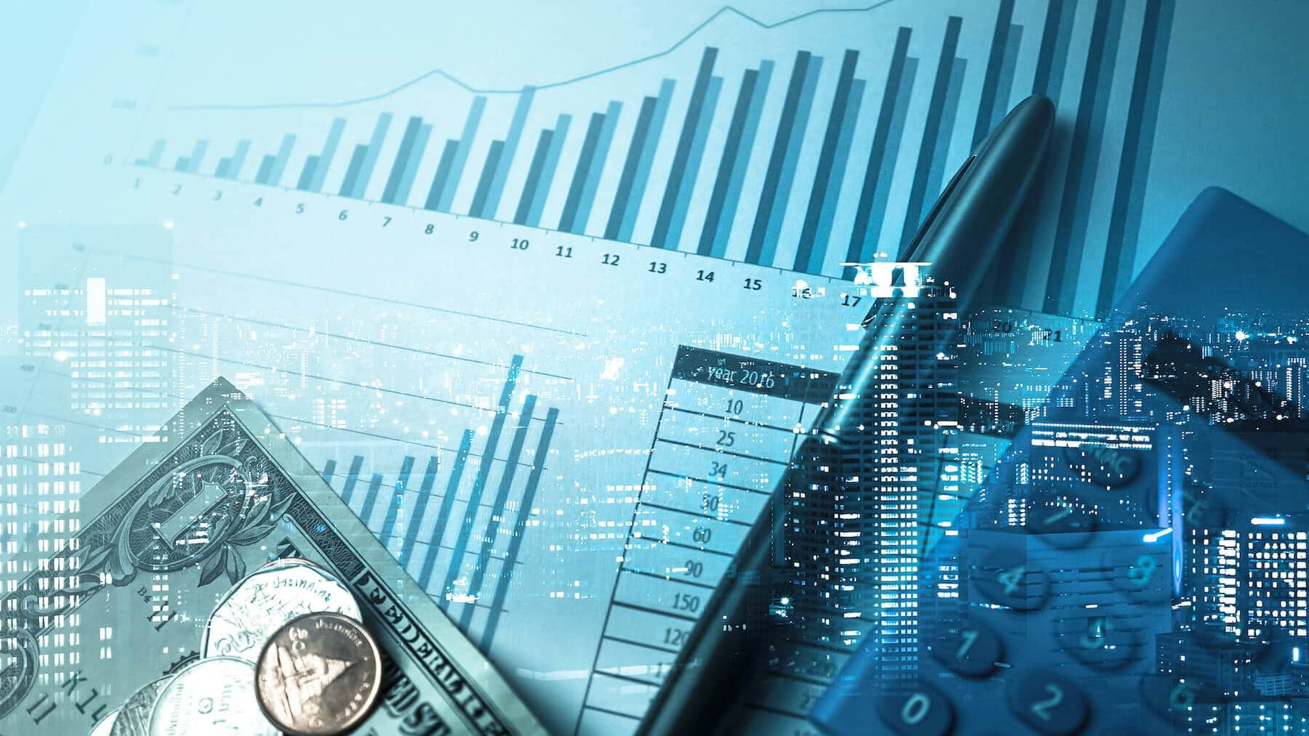
Company Bankruptcy Projections
George Smith
IST 652

Slide 2
Executive Summary
Questions
The purpose of this project is to answer:
Are there any companies in the S&P 500 with financial similarities to bankrupt companies ?
What Financial indicators heavily influence if a company is likely to face bankruptcy ?
What financial indicators have little influence on the likelihood of a company facing bankruptcy ?
Financial Metrics
The financial metrics considered include
ROA
Current Ratio
Quick Ratio
Debt / Equity
Gross Margin
90 additional metrics were considered in the modeling portion of the assignment

Slide 3
Data Sources
Dataset 1
Provided by the Taiwan Economic Journal
95 Columns by 6,820 rows
All Columns represent various Financial metrics (e.g., ROA, Operating Gross Margin, Net Value Per Share, etc.)
A Boolean indicator is included in this dataset that represents if a company has gone bankrupt or not
Dataset 2
Web -scraped Financial information for every ticker represented in the S&P 500
Financials were scraped from FinViz.com
18 columns by 505 rows consisting of various financial metrics

Slide 4
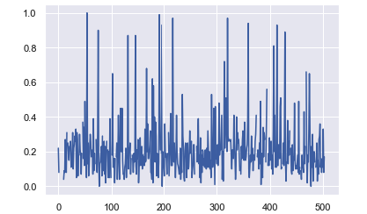
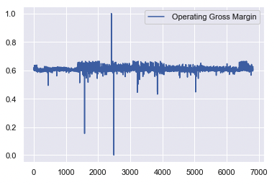
Analysis
Operating Gross Margin
The average Operating Gross Margin of Bankrupt companies was 60%
Many companies in the S & P 500 have similar Operating Gross Margin values , these include: Brown-Forman Corporation , Colgate-Palmolive Company, Equifax, Hasbro, Coca-Cola Co, Mid-American Apartment Communities, Healthpeak Properties, Teradyne Inc., Take-Two Interactive Software, WEC Energy Group Inc.
13 Companies have values within 1% of the average Operating Gross Margin of Bankrupt Companies
S&P 500
S&P 500
Bankrupt Companies

Slide 5
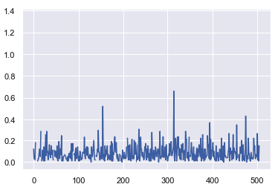
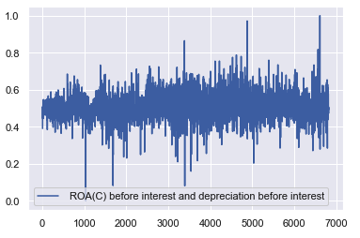
Analysis
ROA
The average ROA of Bankrupt companies was 50%
eBay is the only company with a similar ROA of 51.5%
S&P 500
Bankrupt Companies

Slide 6
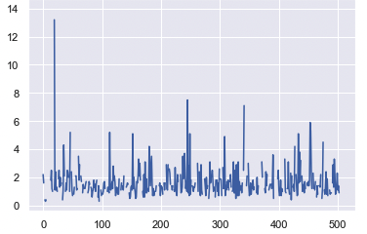
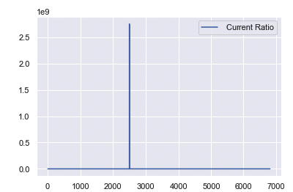
Analysis
Current Ratio
The average Current Ratio of Bankrupt companies was 416,729
No companies is the S&P 500 have a current ratio this high
A maximum value 2,750,000,000 was found in dataset representing Bankrupt companies. This far exceeds any companies in the S&P 500
The largest Current Ratio found in the S&P 500 was Aadi Bioscience with a value of 14
Its difficult to draw any conclusions regarding Current Ratio due to the discrepancy in values
Bankrupt Companies
S&P 500
Bankrupt Companies

Slide 7
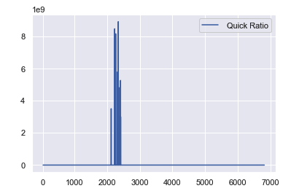
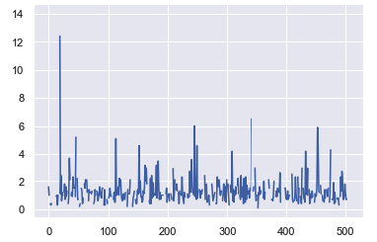
Analysis
Quick Ratio
The average quick ratio of Bankrupt companies was 7,257,160
The largest Quick Ratio found in the S&P 500 was Aadi Bioscience with a value of 14
It is difficult to draw any conclusions about Quick Ratio due to the discrepancy in values
S&P 500
Bankrupt Companies

Slide 8
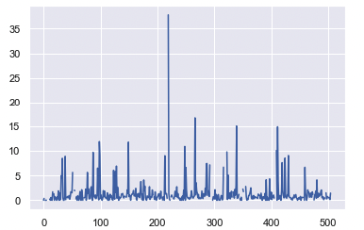
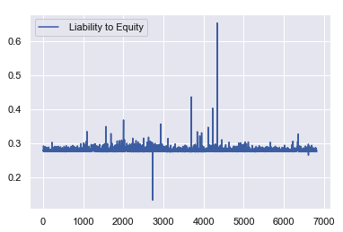
Analysis
Liability to Equity
The average Liability to Equity of Bankrupt companies was .28
10 companies in the S & P 500 have similar Liability to Equities within .01 of Bankrupt companies. These include : Chubb Ltd, Coterra Energy Inc, Harford Financial Services Group Inc., Metlife Inc, Mohawk Industries, Inc, New Corp Class A, Paychex Inc, Principal Financial Group, Progressive Corp, Exxon Mobil Corp
S&P 500
Bankrupt Companies

Slide 9
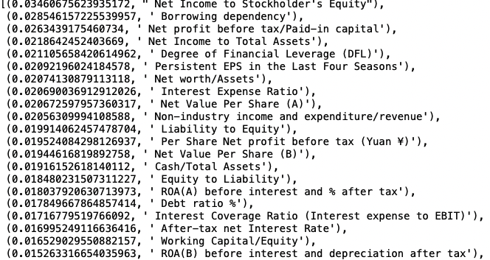
Bankruptcy Indicators
Key Metrics
Using random forest modeling and considering all 95 financial metrics found in the Bankruptcy data, the below are considered the most influential for Bankruptcy predictions :

Slide 10
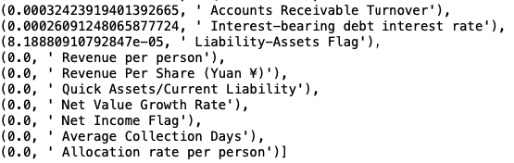
Bankruptcy Indicators
Useless Metrics
Using random forest modeling and considering all 95 financial metrics found in the Bankruptcy data, the below are considered the least influential for Bankruptcy predictions :

Slide 11
Appendix
Definitions
Operating Gross Margin – the ratio of operating income to net sales, usually expressed in percent.
ROA – a financial ratio that indicates how profitable a company is in relation to its total assets.
Current Ratio – A liquidity ratio that measures a company's ability to pay short-term obligations or those due within one year.
Quick Ratio - Indicator of a company's short-term liquidity position and measures a company's ability to meet its short-term obligations
Liability to Equity - evaluate a company's financial leverage and is calculated by dividing a company's total liabilities by its total equity

